Slide 1
Shortest Paths in a Directed Graph
Instructor: Kshitij Gajjar
Centre for Security, Theory and Algorithmic Research (CSTAR)
International Institute of Information Technology, Hyderabad

Slide 2
Bellman-Ford-Moore Algorithm
$$s=$$
A
$$7$$
A | B | C | D | E | F
$$4$$
C
$$−5$$
B
$$3$$
$$5$$
$$6$$
E
$$−4$$
$$−2$$
$$9$$
D
$$5$$
F
$$=t$$

Slide 3
Bellman-Ford-Moore Algorithm
$$s=$$
A
$$7$$
A | B | C | D | E | F
$$0$$ | $$∞$$ | $$∞$$ | $$∞$$ | $$∞$$ | $$∞$$
$$4$$
C
$$−5$$
B
$$3$$
$$5$$
$$6$$
E
$$−4$$
$$−2$$
$$9$$
D
$$5$$
F
$$=t$$

Slide 4
Bellman-Ford-Moore Algorithm
$$s=$$
$$0$$
$$7$$
A | B | C | D | E | F
$$0$$ | $$∞$$ | $$∞$$ | $$∞$$ | $$∞$$ | $$∞$$
$$4$$
$$∞$$
$$−5$$
$$∞$$
$$3$$
$$5$$
$$6$$
$$∞$$
$$−4$$
$$−2$$
$$9$$
$$∞$$
$$5$$
$$∞$$
$$=t$$

Slide 5
Bellman-Ford-Moore Algorithm
$$0$$
$$7$$
A | B | C | D | E | F
$$0$$ | $$∞$$ | $$∞$$ | $$∞$$ | $$∞$$ | $$∞$$
$$0$$
$$4$$
$$∞$$
$$−5$$
$$∞$$
$$3$$
$$5$$
$$6$$
$$∞$$
$$−4$$
$$−2$$
$$9$$
$$∞$$
$$5$$
$$∞$$

Slide 6
Bellman-Ford-Moore Algorithm
$$0$$
$$7$$
A | B | C | D | E | F
$$0$$ | $$∞$$ | $$∞$$ | $$∞$$ | $$∞$$ | $$∞$$
$$0$$ | $$4$$
$$4$$
$$∞$$
$$−5$$
$$∞$$
$$3$$
$$5$$
$$6$$
$$∞$$
$$−4$$
$$−2$$
$$9$$
$$∞$$
$$5$$
$$∞$$

Slide 7
Bellman-Ford-Moore Algorithm
$$0$$
$$7$$
A | B | C | D | E | F
$$0$$ | $$∞$$ | $$∞$$ | $$∞$$ | $$∞$$ | $$∞$$
$$0$$ | $$4$$
$$4$$
$$∞$$
$$−5$$
$$4$$
$$3$$
$$5$$
$$6$$
$$∞$$
$$−4$$
$$−2$$
$$9$$
$$∞$$
$$5$$
$$∞$$

Slide 8
Bellman-Ford-Moore Algorithm
$$0$$
$$7$$
A | B | C | D | E | F
$$0$$ | $$∞$$ | $$∞$$ | $$∞$$ | $$∞$$ | $$∞$$
$$0$$ | $$4$$ | $$7$$
$$4$$
$$∞$$
$$−5$$
$$4$$
$$3$$
$$5$$
$$6$$
$$∞$$
$$−4$$
$$−2$$
$$9$$
$$∞$$
$$5$$
$$∞$$

Slide 9
Bellman-Ford-Moore Algorithm
$$0$$
$$7$$
A | B | C | D | E | F
$$0$$ | $$∞$$ | $$∞$$ | $$∞$$ | $$∞$$ | $$∞$$
$$0$$ | $$4$$ | $$7$$
$$4$$
$$7$$
$$−5$$
$$4$$
$$3$$
$$5$$
$$6$$
$$∞$$
$$−4$$
$$−2$$
$$9$$
$$∞$$
$$5$$
$$∞$$

Slide 10
Bellman-Ford-Moore Algorithm
$$0$$
$$7$$
A | B | C | D | E | F
$$0$$ | $$∞$$ | $$∞$$ | $$∞$$ | $$∞$$ | $$∞$$
$$0$$ | $$4$$ | $$7$$ | $$10$$
$$4$$
$$7$$
$$−5$$
$$4$$
$$3$$
$$5$$
$$6$$
$$∞$$
$$−4$$
$$−2$$
$$9$$
$$∞$$
$$5$$
$$∞$$

Slide 11
Bellman-Ford-Moore Algorithm
$$0$$
$$7$$
A | B | C | D | E | F
$$0$$ | $$∞$$ | $$∞$$ | $$∞$$ | $$∞$$ | $$∞$$
$$0$$ | $$4$$ | $$7$$ | $$10$$
$$4$$
$$7$$
$$−5$$
$$4$$
$$3$$
$$5$$
$$6$$
$$∞$$
$$−4$$
$$−2$$
$$9$$
$$10$$
$$5$$
$$∞$$

Slide 12
Bellman-Ford-Moore Algorithm
$$0$$
$$7$$
A | B | C | D | E | F
$$0$$ | $$∞$$ | $$∞$$ | $$∞$$ | $$∞$$ | $$∞$$
$$0$$ | $$4$$ | $$7$$ | $$10$$ | $$8$$
$$4$$
$$7$$
$$−5$$
$$4$$
$$3$$
$$5$$
$$6$$
$$∞$$
$$−4$$
$$−2$$
$$9$$
$$10$$
$$5$$
$$∞$$

Slide 13
Bellman-Ford-Moore Algorithm
$$0$$
$$7$$
A | B | C | D | E | F
$$0$$ | $$∞$$ | $$∞$$ | $$∞$$ | $$∞$$ | $$∞$$
$$0$$ | $$4$$ | $$7$$ | $$10$$ | $$8$$
$$4$$
$$7$$
$$−5$$
$$4$$
$$3$$
$$5$$
$$6$$
$$8$$
$$−4$$
$$−2$$
$$9$$
$$10$$
$$5$$
$$∞$$

Slide 14
Bellman-Ford-Moore Algorithm
$$0$$
$$7$$
A | B | C | D | E | F
$$0$$ | $$∞$$ | $$∞$$ | $$∞$$ | $$∞$$ | $$∞$$
$$0$$ | $$4$$ | $$7$$ | $$10$$ | $$8$$ | $$15$$
$$4$$
$$7$$
$$−5$$
$$4$$
$$3$$
$$5$$
$$6$$
$$8$$
$$−4$$
$$−2$$
$$9$$
$$10$$
$$5$$
$$∞$$

Slide 15
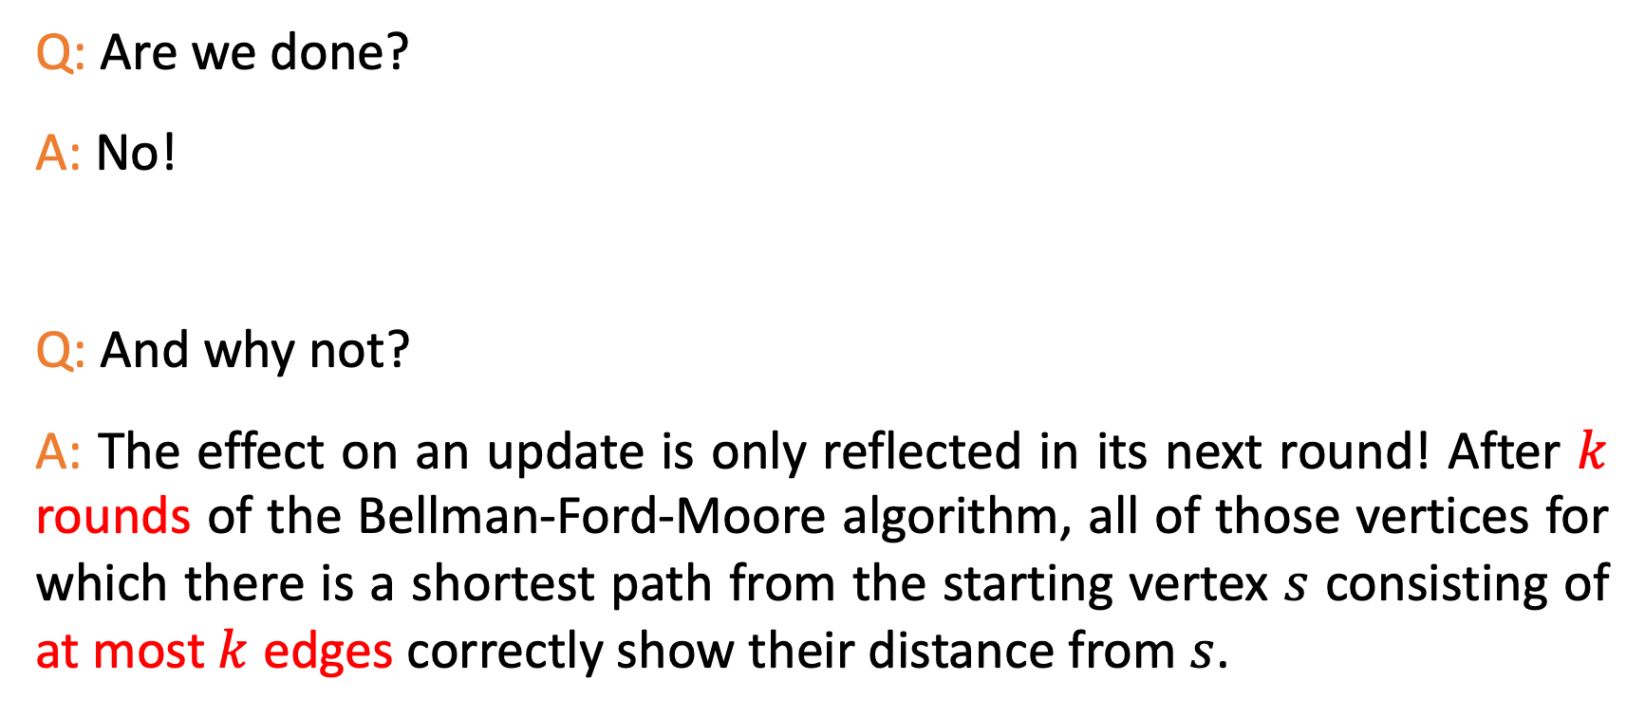
A Puzzle
Q: Are we done?
A: No!
Q: And why not?
A: The effect on an update is only reflected in its next round! After $k$ rounds of the Bellman-Ford-Moore algorithm, all of those vertices for which there is a shortest path from the starting vertex $s$ consisting of at most $k$ edges correctly show their distance from $s$.

Slide 16
Bellman-Ford-Moore Algorithm
$$0$$
$$7$$
A | B | C | D | E | F
$$0$$ | $$∞$$ | $$∞$$ | $$∞$$ | $$∞$$ | $$∞$$
$$0$$ | $$4$$ | $$7$$ | $$10$$ | $$8$$ | $$15$$
$$0$$
$$4$$
$$7$$
$$−5$$
$$4$$
$$3$$
$$5$$
$$6$$
$$8$$
$$−4$$
$$−2$$
$$9$$
$$10$$
$$5$$
$$15$$

Slide 17
Bellman-Ford-Moore Algorithm
$$0$$
$$7$$
A | B | C | D | E | F
$$0$$ | $$∞$$ | $$∞$$ | $$∞$$ | $$∞$$ | $$∞$$
$$0$$ | $$4$$ | $$7$$ | $$10$$ | $$8$$ | $$15$$
$$0$$ | $$2$$
$$4$$
$$7$$
$$−5$$
$$4$$
$$3$$
$$5$$
$$6$$
$$8$$
$$−4$$
$$−2$$
$$9$$
$$10$$
$$5$$
$$15$$

Slide 18
Bellman-Ford-Moore Algorithm
$$0$$
$$7$$
A | B | C | D | E | F
$$0$$ | $$∞$$ | $$∞$$ | $$∞$$ | $$∞$$ | $$∞$$
$$0$$ | $$4$$ | $$7$$ | $$10$$ | $$8$$ | $$15$$
$$0$$ | $$2$$
$$4$$
$$7$$
$$−5$$
$$2$$
$$3$$
$$5$$
$$6$$
$$8$$
$$−4$$
$$−2$$
$$9$$
$$10$$
$$5$$
$$15$$

Slide 19
Bellman-Ford-Moore Algorithm
$$0$$
$$7$$
A | B | C | D | E | F
$$0$$ | $$∞$$ | $$∞$$ | $$∞$$ | $$∞$$ | $$∞$$
$$0$$ | $$4$$ | $$7$$ | $$10$$ | $$8$$ | $$15$$
$$0$$ | $$2$$ | $$7$$
$$4$$
$$7$$
$$−5$$
$$2$$
$$3$$
$$5$$
$$6$$
$$8$$
$$−4$$
$$−2$$
$$9$$
$$10$$
$$5$$
$$15$$

Slide 20
Bellman-Ford-Moore Algorithm
$$0$$
$$7$$
A | B | C | D | E | F
$$0$$ | $$∞$$ | $$∞$$ | $$∞$$ | $$∞$$ | $$∞$$
$$0$$ | $$4$$ | $$7$$ | $$10$$ | $$8$$ | $$15$$
$$0$$ | $$2$$ | $$7$$
$$4$$
$$7$$
$$−5$$
$$2$$
$$3$$
$$5$$
$$6$$
$$8$$
$$−4$$
$$−2$$
$$9$$
$$10$$
$$5$$
$$15$$

Slide 21
Bellman-Ford-Moore Algorithm
$$0$$
$$7$$
A | B | C | D | E | F
$$0$$ | $$∞$$ | $$∞$$ | $$∞$$ | $$∞$$ | $$∞$$
$$0$$ | $$4$$ | $$7$$ | $$10$$ | $$8$$ | $$15$$
$$0$$ | $$2$$ | $$7$$ | $$8$$
$$4$$
$$7$$
$$−5$$
$$2$$
$$3$$
$$5$$
$$6$$
$$8$$
$$−4$$
$$−2$$
$$9$$
$$10$$
$$5$$
$$15$$

Slide 22
Bellman-Ford-Moore Algorithm
$$0$$
$$7$$
A | B | C | D | E | F
$$0$$ | $$∞$$ | $$∞$$ | $$∞$$ | $$∞$$ | $$∞$$
$$0$$ | $$4$$ | $$7$$ | $$10$$ | $$8$$ | $$15$$
$$0$$ | $$2$$ | $$7$$ | $$8$$
$$4$$
$$7$$
$$−5$$
$$2$$
$$3$$
$$5$$
$$6$$
$$8$$
$$−4$$
$$−2$$
$$9$$
$$8$$
$$5$$
$$15$$

Slide 23
Bellman-Ford-Moore Algorithm
$$0$$
$$7$$
A | B | C | D | E | F
$$0$$ | $$∞$$ | $$∞$$ | $$∞$$ | $$∞$$ | $$∞$$
$$0$$ | $$4$$ | $$7$$ | $$10$$ | $$8$$ | $$15$$
$$0$$ | $$2$$ | $$7$$ | $$8$$ | $$6$$
$$4$$
$$7$$
$$−5$$
$$2$$
$$3$$
$$5$$
$$6$$
$$8$$
$$−4$$
$$−2$$
$$9$$
$$8$$
$$5$$
$$15$$

Slide 24
Bellman-Ford-Moore Algorithm
$$0$$
$$7$$
A | B | C | D | E | F
$$0$$ | $$∞$$ | $$∞$$ | $$∞$$ | $$∞$$ | $$∞$$
$$0$$ | $$4$$ | $$7$$ | $$10$$ | $$8$$ | $$15$$
$$0$$ | $$2$$ | $$7$$ | $$8$$ | $$6$$
$$4$$
$$7$$
$$−5$$
$$2$$
$$3$$
$$5$$
$$6$$
$$6$$
$$−4$$
$$−2$$
$$9$$
$$8$$
$$5$$
$$15$$

Slide 25
Bellman-Ford-Moore Algorithm
$$0$$
$$7$$
A | B | C | D | E | F
$$0$$ | $$∞$$ | $$∞$$ | $$∞$$ | $$∞$$ | $$∞$$
$$0$$ | $$4$$ | $$7$$ | $$10$$ | $$8$$ | $$15$$
$$0$$ | $$2$$ | $$7$$ | $$8$$ | $$6$$ | $$13$$
$$4$$
$$7$$
$$−5$$
$$2$$
$$3$$
$$5$$
$$6$$
$$6$$
$$−4$$
$$−2$$
$$9$$
$$8$$
$$5$$
$$15$$

Slide 26
Bellman-Ford-Moore Algorithm
$$0$$
$$7$$
A | B | C | D | E | F
$$0$$ | $$∞$$ | $$∞$$ | $$∞$$ | $$∞$$ | $$∞$$
$$0$$ | $$4$$ | $$7$$ | $$10$$ | $$8$$ | $$15$$
$$0$$ | $$2$$ | $$7$$ | $$8$$ | $$6$$ | $$13$$
$$0$$
$$4$$
$$7$$
$$−5$$
$$2$$
$$3$$
$$5$$
$$6$$
$$6$$
$$−4$$
$$−2$$
$$9$$
$$8$$
$$5$$
$$13$$

Slide 27
Bellman-Ford-Moore Algorithm
$$0$$
$$7$$
A | B | C | D | E | F
$$0$$ | $$∞$$ | $$∞$$ | $$∞$$ | $$∞$$ | $$∞$$
$$0$$ | $$4$$ | $$7$$ | $$10$$ | $$8$$ | $$15$$
$$0$$ | $$2$$ | $$7$$ | $$8$$ | $$6$$ | $$13$$
$$0$$ | $$2$$
$$4$$
$$7$$
$$−5$$
$$2$$
$$3$$
$$5$$
$$6$$
$$6$$
$$−4$$
$$−2$$
$$9$$
$$8$$
$$5$$
$$13$$

Slide 28
Bellman-Ford-Moore Algorithm
$$0$$
$$7$$
A | B | C | D | E | F
$$0$$ | $$∞$$ | $$∞$$ | $$∞$$ | $$∞$$ | $$∞$$
$$0$$ | $$4$$ | $$7$$ | $$10$$ | $$8$$ | $$15$$
$$0$$ | $$2$$ | $$7$$ | $$8$$ | $$6$$ | $$13$$
$$0$$ | $$2$$
$$4$$
$$7$$
$$−5$$
$$2$$
$$3$$
$$5$$
$$6$$
$$6$$
$$−4$$
$$−2$$
$$9$$
$$8$$
$$5$$
$$13$$

Slide 29
Bellman-Ford-Moore Algorithm
$$0$$
$$7$$
A | B | C | D | E | F
$$0$$ | $$∞$$ | $$∞$$ | $$∞$$ | $$∞$$ | $$∞$$
$$0$$ | $$4$$ | $$7$$ | $$10$$ | $$8$$ | $$15$$
$$0$$ | $$2$$ | $$7$$ | $$8$$ | $$6$$ | $$13$$
$$0$$ | $$2$$ | $$7$$
$$4$$
$$7$$
$$−5$$
$$2$$
$$3$$
$$5$$
$$6$$
$$6$$
$$−4$$
$$−2$$
$$9$$
$$8$$
$$5$$
$$13$$

Slide 30
Bellman-Ford-Moore Algorithm
$$0$$
$$7$$
A | B | C | D | E | F
$$0$$ | $$∞$$ | $$∞$$ | $$∞$$ | $$∞$$ | $$∞$$
$$0$$ | $$4$$ | $$7$$ | $$10$$ | $$8$$ | $$15$$
$$0$$ | $$2$$ | $$7$$ | $$8$$ | $$6$$ | $$13$$
$$0$$ | $$2$$ | $$7$$
$$4$$
$$7$$
$$−5$$
$$2$$
$$3$$
$$5$$
$$6$$
$$6$$
$$−4$$
$$−2$$
$$9$$
$$8$$
$$5$$
$$13$$

Slide 31
Bellman-Ford-Moore Algorithm
$$0$$
$$7$$
A | B | C | D | E | F
$$0$$ | $$∞$$ | $$∞$$ | $$∞$$ | $$∞$$ | $$∞$$
$$0$$ | $$4$$ | $$7$$ | $$10$$ | $$8$$ | $$15$$
$$0$$ | $$2$$ | $$7$$ | $$8$$ | $$6$$ | $$13$$
$$0$$ | $$2$$ | $$7$$ | $$8$$
$$4$$
$$7$$
$$−5$$
$$2$$
$$3$$
$$5$$
$$6$$
$$6$$
$$−4$$
$$−2$$
$$9$$
$$8$$
$$5$$
$$13$$

Slide 32
Bellman-Ford-Moore Algorithm
$$0$$
$$7$$
A | B | C | D | E | F
$$0$$ | $$∞$$ | $$∞$$ | $$∞$$ | $$∞$$ | $$∞$$
$$0$$ | $$4$$ | $$7$$ | $$10$$ | $$8$$ | $$15$$
$$0$$ | $$2$$ | $$7$$ | $$8$$ | $$6$$ | $$13$$
$$0$$ | $$2$$ | $$7$$ | $$8$$
$$4$$
$$7$$
$$−5$$
$$2$$
$$3$$
$$5$$
$$6$$
$$6$$
$$−4$$
$$−2$$
$$9$$
$$8$$
$$5$$
$$13$$

Slide 33
Bellman-Ford-Moore Algorithm
$$0$$
$$7$$
A | B | C | D | E | F
$$0$$ | $$∞$$ | $$∞$$ | $$∞$$ | $$∞$$ | $$∞$$
$$0$$ | $$4$$ | $$7$$ | $$10$$ | $$8$$ | $$15$$
$$0$$ | $$2$$ | $$7$$ | $$8$$ | $$6$$ | $$13$$
$$0$$ | $$2$$ | $$7$$ | $$8$$ | $$6$$
$$4$$
$$7$$
$$−5$$
$$2$$
$$3$$
$$5$$
$$6$$
$$6$$
$$−4$$
$$−2$$
$$9$$
$$8$$
$$5$$
$$13$$

Slide 34
Bellman-Ford-Moore Algorithm
$$0$$
$$7$$
A | B | C | D | E | F
$$0$$ | $$∞$$ | $$∞$$ | $$∞$$ | $$∞$$ | $$∞$$
$$0$$ | $$4$$ | $$7$$ | $$10$$ | $$8$$ | $$15$$
$$0$$ | $$2$$ | $$7$$ | $$8$$ | $$6$$ | $$13$$
$$0$$ | $$2$$ | $$7$$ | $$8$$ | $$6$$
$$4$$
$$7$$
$$−5$$
$$2$$
$$3$$
$$5$$
$$6$$
$$6$$
$$−4$$
$$−2$$
$$9$$
$$8$$
$$5$$
$$13$$

Slide 35
Bellman-Ford-Moore Algorithm
$$0$$
$$7$$
A | B | C | D | E | F
$$0$$ | $$∞$$ | $$∞$$ | $$∞$$ | $$∞$$ | $$∞$$
$$0$$ | $$4$$ | $$7$$ | $$10$$ | $$8$$ | $$15$$
$$0$$ | $$2$$ | $$7$$ | $$8$$ | $$6$$ | $$13$$
$$0$$ | $$2$$ | $$7$$ | $$8$$ | $$6$$
$$4$$
$$7$$
$$−5$$
$$2$$
$$3$$
$$5$$
$$6$$
$$6$$
$$−4$$
$$−2$$
$$9$$
$$8$$
$$5$$
$$13$$

Slide 36
Bellman-Ford-Moore Algorithm
$$0$$
$$7$$
A | B | C | D | E | F
$$0$$ | $$∞$$ | $$∞$$ | $$∞$$ | $$∞$$ | $$∞$$
$$0$$ | $$4$$ | $$7$$ | $$10$$ | $$8$$ | $$15$$
$$0$$ | $$2$$ | $$7$$ | $$8$$ | $$6$$ | $$13$$
$$0$$ | $$2$$ | $$7$$ | $$8$$ | $$6$$ | $$13$$
$$4$$
$$7$$
$$−5$$
$$2$$
$$3$$
$$5$$
$$6$$
$$6$$
$$−4$$
$$−2$$
$$9$$
$$8$$
$$5$$
$$13$$

Slide 37
Bellman-Ford-Moore Algorithm
$$s=$$
$$0$$
$$7$$
A | B | C | D | E | F
$$0$$ | $$∞$$ | $$∞$$ | $$∞$$ | $$∞$$ | $$∞$$
$$0$$ | $$4$$ | $$7$$ | $$10$$ | $$8$$ | $$15$$
$$0$$ | $$2$$ | $$7$$ | $$8$$ | $$6$$ | $$13$$
$$0$$ | $$2$$ | $$7$$ | $$8$$ | $$6$$ | $$13$$
$$0$$ | $$2$$ | $$7$$ | $$8$$ | $$6$$ | $$13$$
$$4$$
$$7$$
$$−5$$
$$2$$
$$3$$
$$5$$
$$6$$
$$6$$
$$−4$$
$$−2$$
$$9$$
$$8$$
$$5$$
$$13$$
$$=t$$

Slide 38
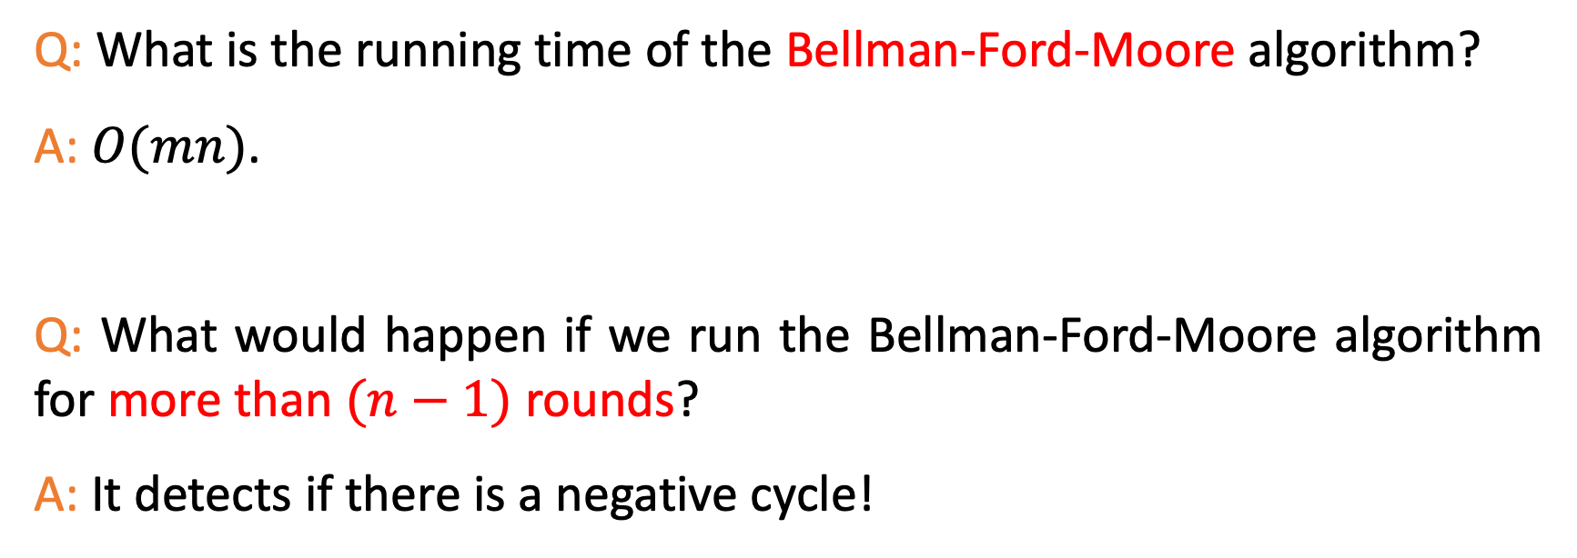
Another Puzzle
Q: What is the running time of the Bellman-Ford-Moore algorithm?
A: $O(mn)$.
Q: What would happen if we run the Bellman-Ford-Moore algorithm for more than $(n−1)$ rounds?
A: It detects if there is a negative cycle!

Slide 39

Thank You!

